Slide 2

Praveen Raghuvanshi
Principal Engineer, Harman International

Slide 3
Applying Data Science and Machine Learning Using Microsoft .Net
Praveen Raghuvanshi

Slide 4
Acknowledgements
Dataset – Cricksheet.org
Organizers – AzConf 2022
Sponsors

Slide 5
Identify Language
Maidin mhaith
Guten Morgen
おはよ ございます
शुभ प्रभात
Good Morning

Slide 6



Programming Languages
Source: https://insights.dice.com/2019/10/24/tiobe-top-eight-top-ten-open/

Slide 7

Data Science – Exploratory Data Analysis(EDA)
As per Wiki…
“In statistics, exploratory data analysis (EDA) is an approach of analyzing data sets to summarize their main characteristics, often with visual methods.”
Buy a House
No of bedrooms
Type (Apartment, Villa)
Locality
Crime Rate
Source: https://insights.dice.com/2019/10/24/tiobe-top-eight-top-ten-open/

Slide 8
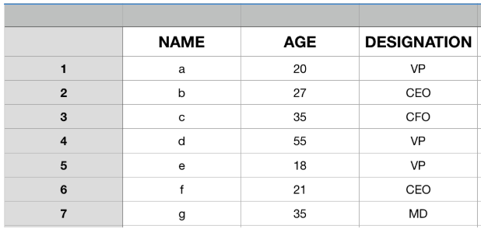
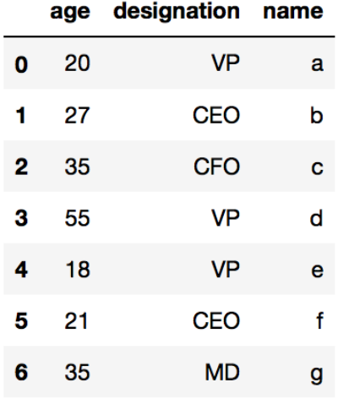
EDA Datastructure : DataFrame

Slide 9
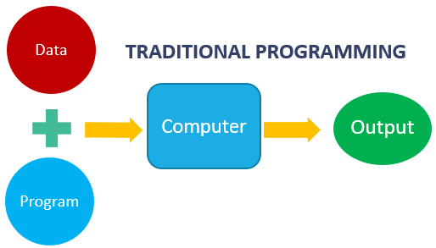
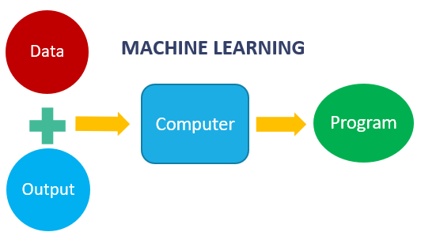
Machine Learning
Machine learning is getting computers to program themselves
If programming is automation, then machine learning is automating the process of automation

Slide 10
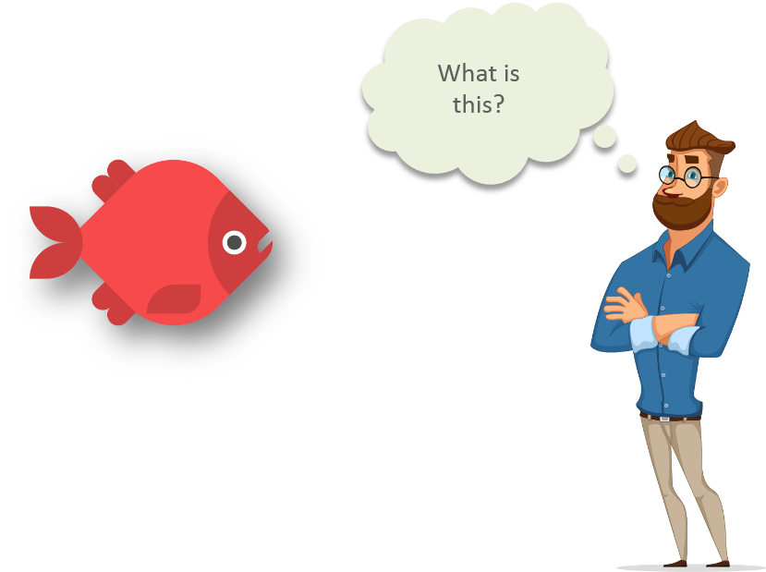
Machine Learning
source: https://www.quora.com/What-are-prerequisites-to-start-learning-machine-learning

Slide 11
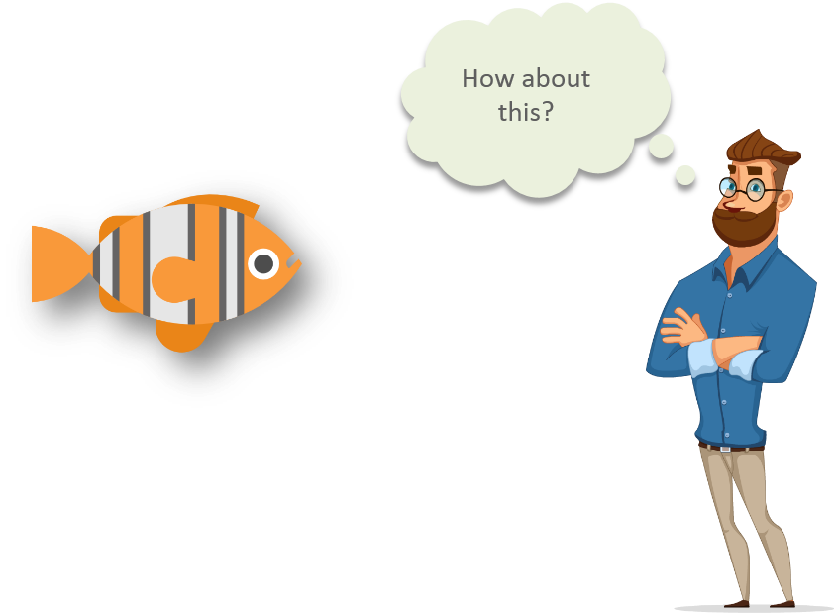
Machine Learning
source: https://www.quora.com/What-are-prerequisites-to-start-learning-machine-learning

Slide 12
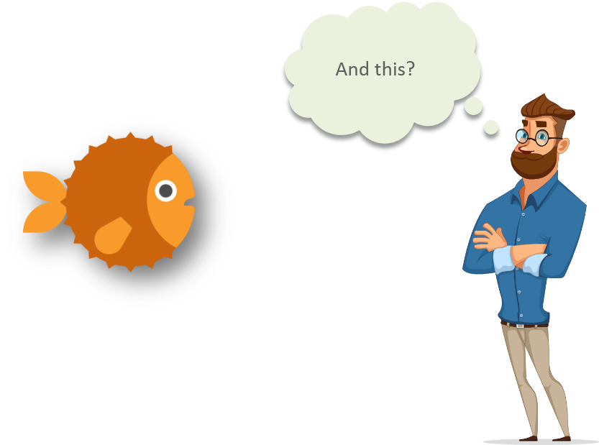
Machine Learning
source: https://www.quora.com/What-are-prerequisites-to-start-learning-machine-learning

Slide 13
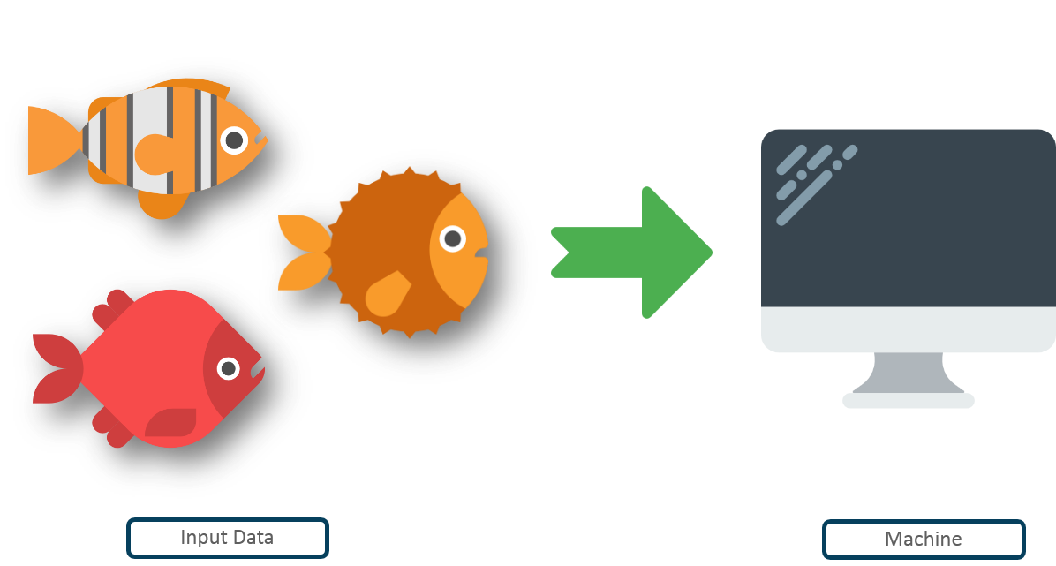
Machine Learning
Input data
Machine
Source: https://www.quora.com/What-are-prerequisites-to-start-learning-machine-learning

Slide 14
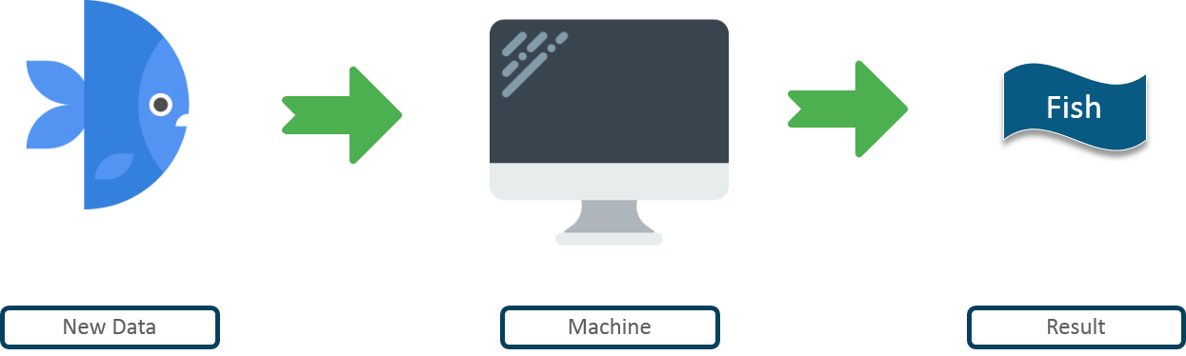
Machine Learning
New Data
Machine
Result
Source: https://www.quora.com/What-are-prerequisites-to-start-learning-machine-learning

Slide 15
Pre-Requisites of ML
A Pattern should exist
Mathematical model/algorithm is unknown
Abundant data

Slide 16
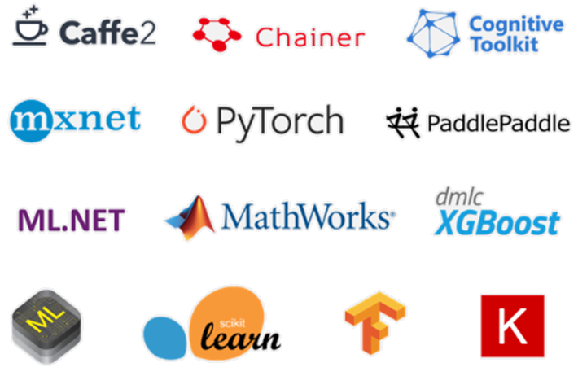
ML Frameworks

Slide 17

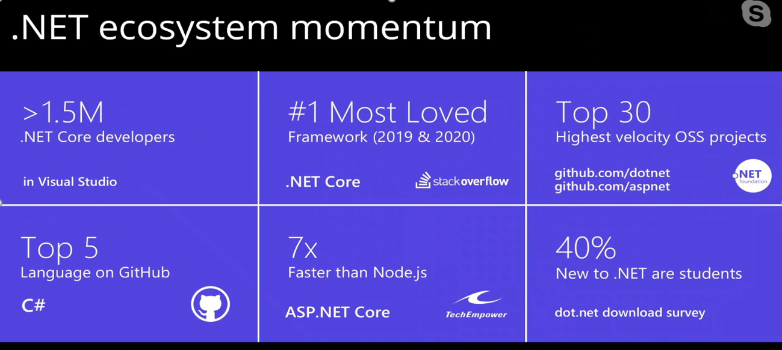
Why ?

Slide 18
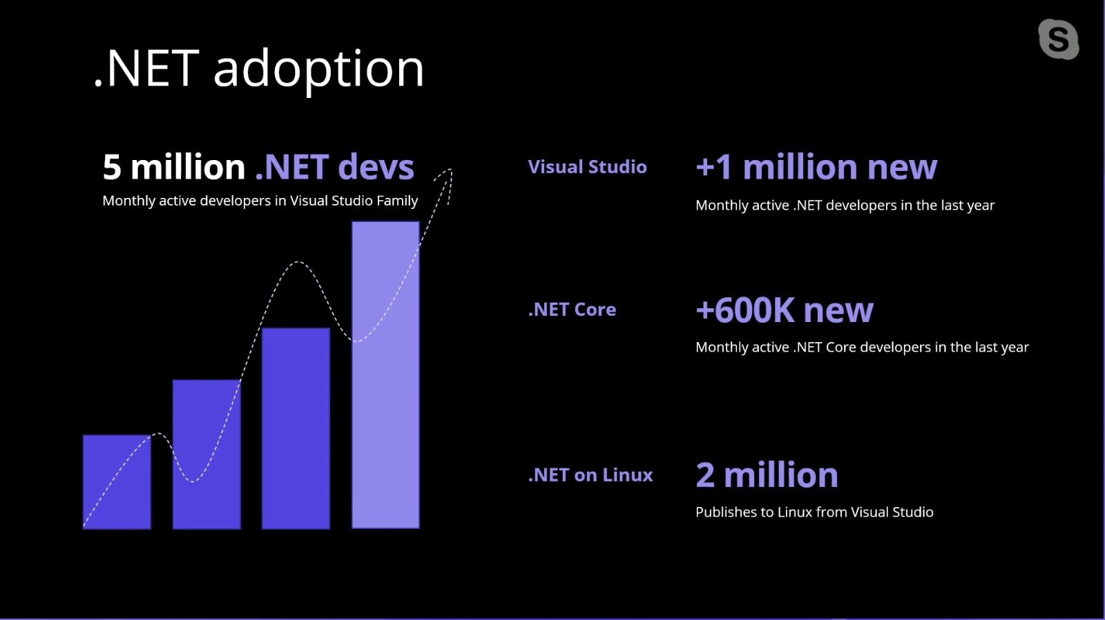
Why ?

Slide 19
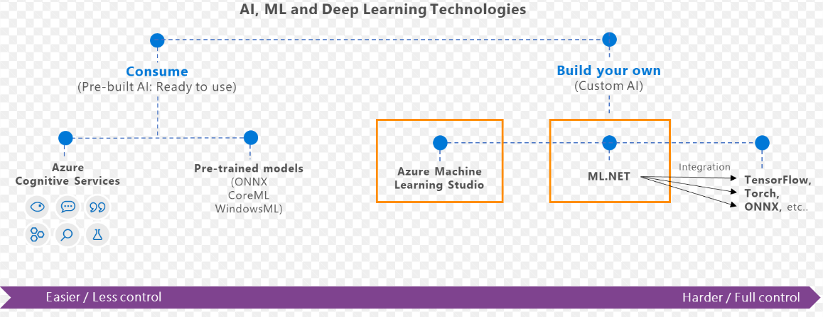
What is ML.Net ?
ML Framework from Microsoft for developing custom AI/ML applications.
Originated in 2002 as part of Microsoft Research Project

Slide 20
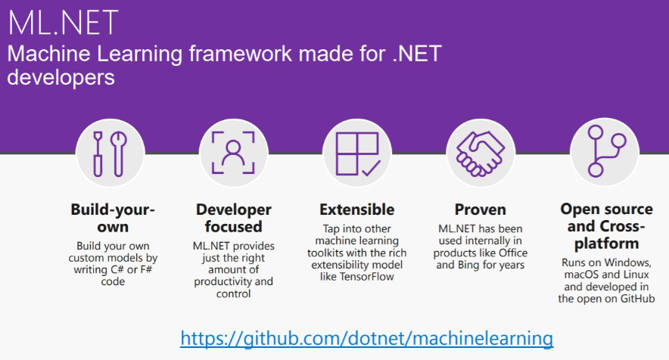
What is ML.Net ?

Slide 21
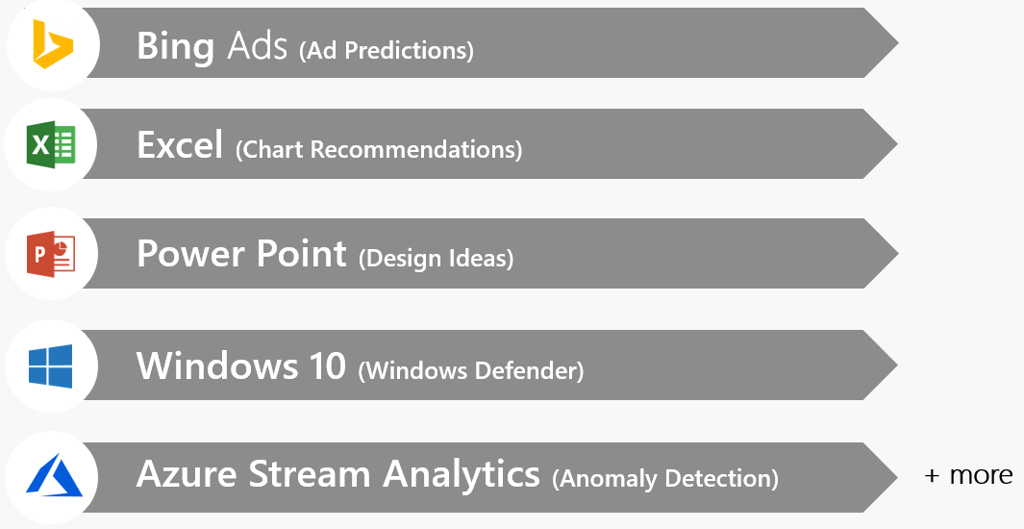
ML.Net – Proven at Scale, Enterprise ready

Slide 22
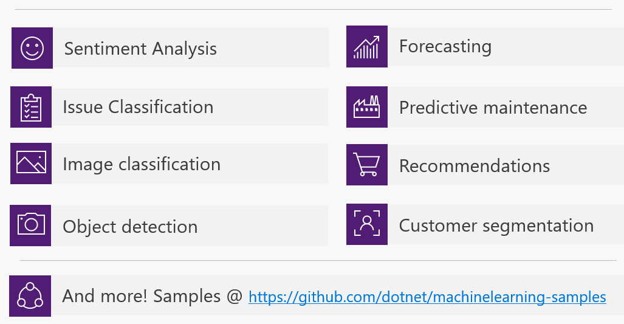
ML.Net – Possibilities

Slide 23
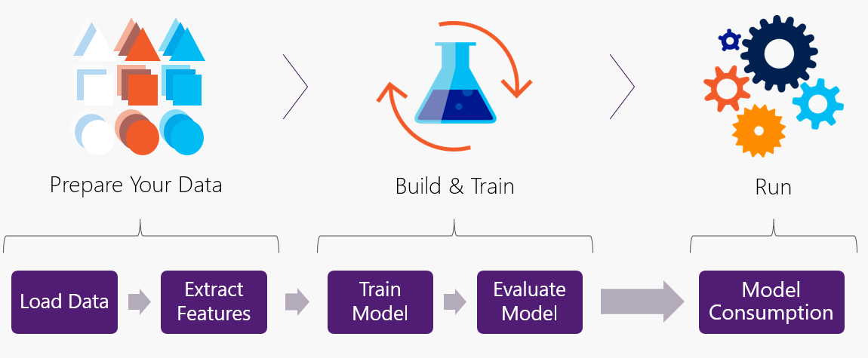
ML.Net – Workflow

Slide 24
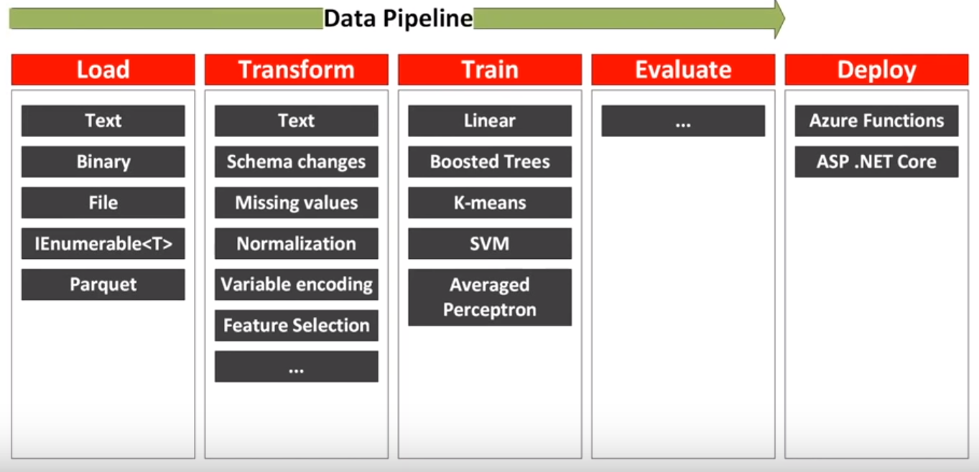
ML.Net – Data Pipeline

Slide 25
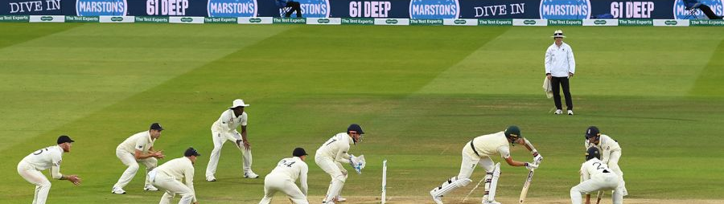
Cricket – EDA and Prediction
Statistics(2019-2020)
Played by 104 Nations
IPL Valuation: $6.7 billion
IPL Viewers : 370 Million

Slide 26






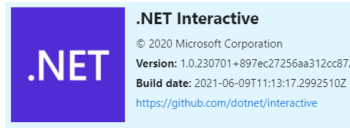
Tools and Frameworks

Slide 27
Cricket : Problem Statement
Perform analysis on cricket dataset
Predict score on a specific ball within 6 overs

Slide 28
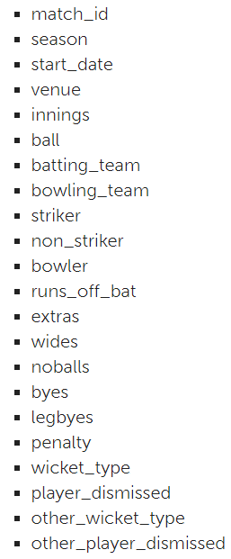
Dataset
T20 Match - Men
Duration: 2017 – 2021
Matches : 1010
Teams: 56
Columns: 22
Records: 231 K
Mix of number and strings

Slide 29
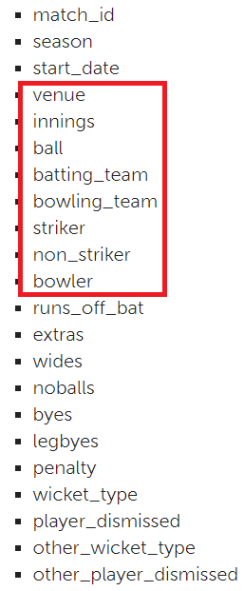
Data Cleaning
Filter dataset to include records till 6 over. Low memory and fast execution
Check for Null Values
Aggregation : Score per ball → runs_off_bat + extras
Cumulative sum : Total Score per ball
Remove features/columns

Slide 30
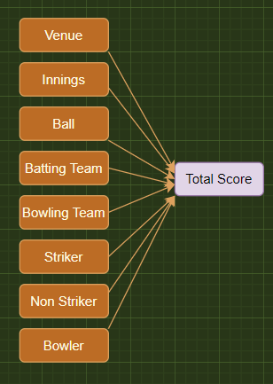
Prediction
Regression using ML.Net
Define Classes : Match, MatchScorePrediction
Load Dataset
Split Dataset: Train/Test : 80/20
One Hot Encoding
Model Algorithm : FastTree
Train → Evaluate → Predict the Model

Slide 31
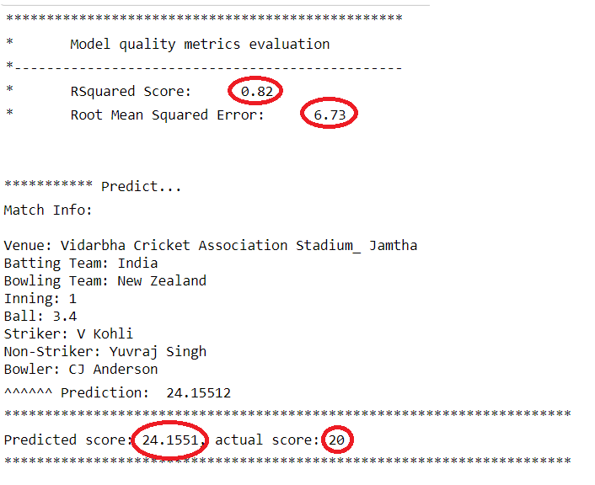
ML.Net – API (Jupyter Notebook)

Slide 32
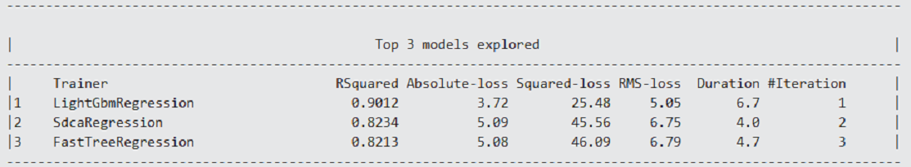
ML.Net – AutoML (Model Builder)

Slide 33
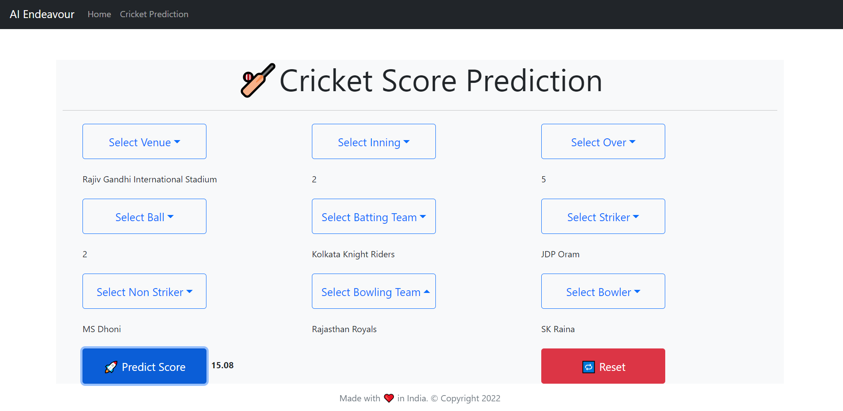
ML.Net – Web App

Slide 34
Demo

Slide 35
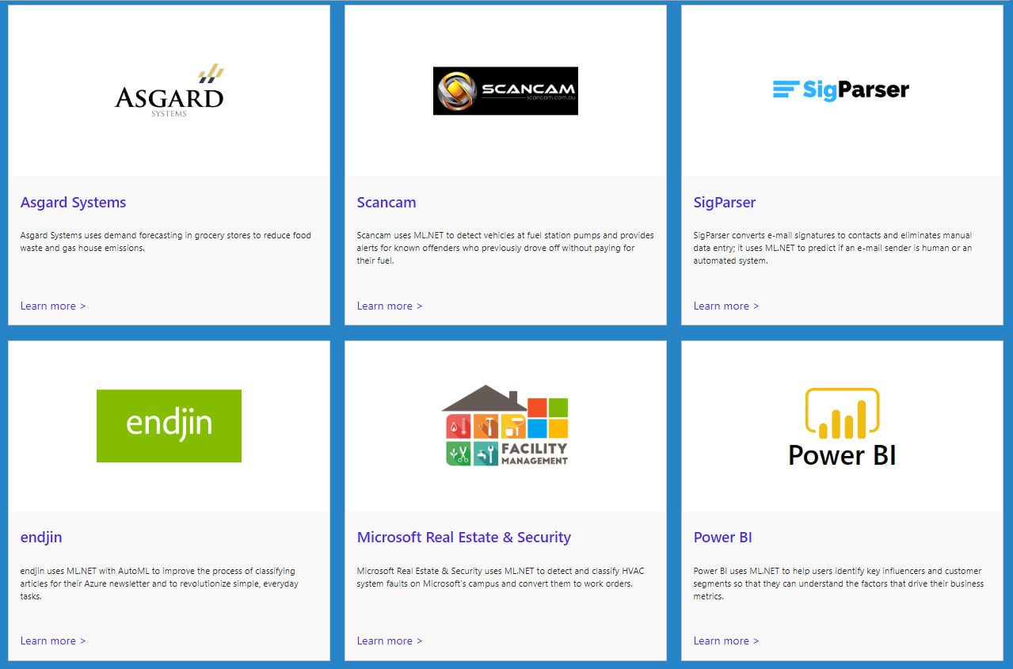
ML.Net : Customer Stories
https://dotnet.microsoft.com/apps/machinelearning-ai/ml-dotnet/customers

Slide 36
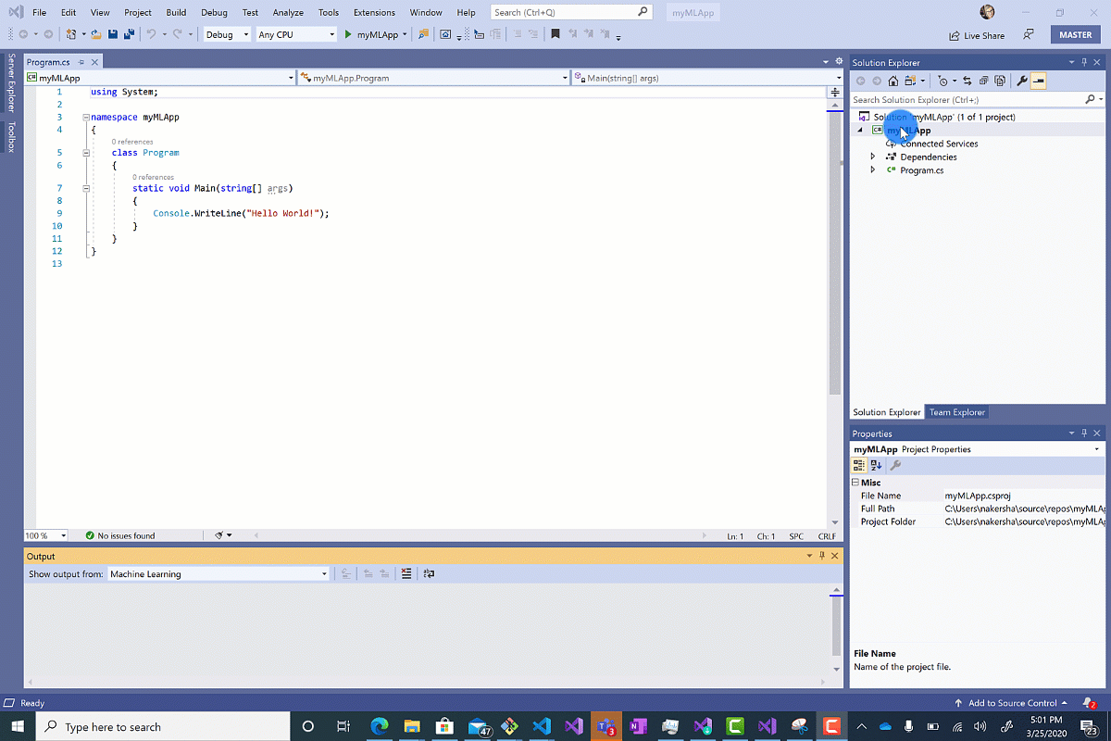
ML.Net : Model Builder(AutoML)

Slide 37
References
ML.Net : https://dotnet.microsoft.com/apps/machinelearning-ai/ml-dotnet
ML.Net: https://devblogs.microsoft.com/cesardelatorre/what-is-ml-net-1-0-machine-learning-for-net/
ONNX : https://onnx.ai/
Photo-Search (ONNX) : https://github.com/Tak-Au/Photo-Search
Music Repair : https://www.youtube.com/watch?v=nnV-1q-z9uE
ML Cookbook : https://github.com/dotnet/machinelearning/blob/master/docs/code/MlNetCookBook.md
Deploy to Azure functions : http://luisquintanilla.me/2018/08/21/serverless-machine-learning-mlnet-azure-functions/
https://rubikscode.net/2019/02/18/ultimate-guide-to-machine-learning-with-ml-net/
https://www.youtube.com/watch?v=dojO4zEL9sg
https://www.youtube.com/watch?v=zy7Y9CHji2k
https://dotnet.microsoft.com/apps/machinelearning-ai/ml-dotnet/customers

Slide 38

Resource
Github: https://github.com/praveenraghuvanshi/tech-sessions/tree/master/21102022-AI-ML-using-ml-dotnet-azconf-2022
Dev.to : Cricket Analysis and Prediction using ML.Net(C#) - DEV Community 👩‍💻👨‍💻
Short Url: https://bit.ly/3MH34hv

Slide 39






Platinum Partner
Gold Partner
Silver Partner

Slide 40
Q & A

Slide 41
Applying Data Science and Machine Learning using Microsoft .Net
Praveen Raghuvanshi
@praveenraghuvan

